Slide 1
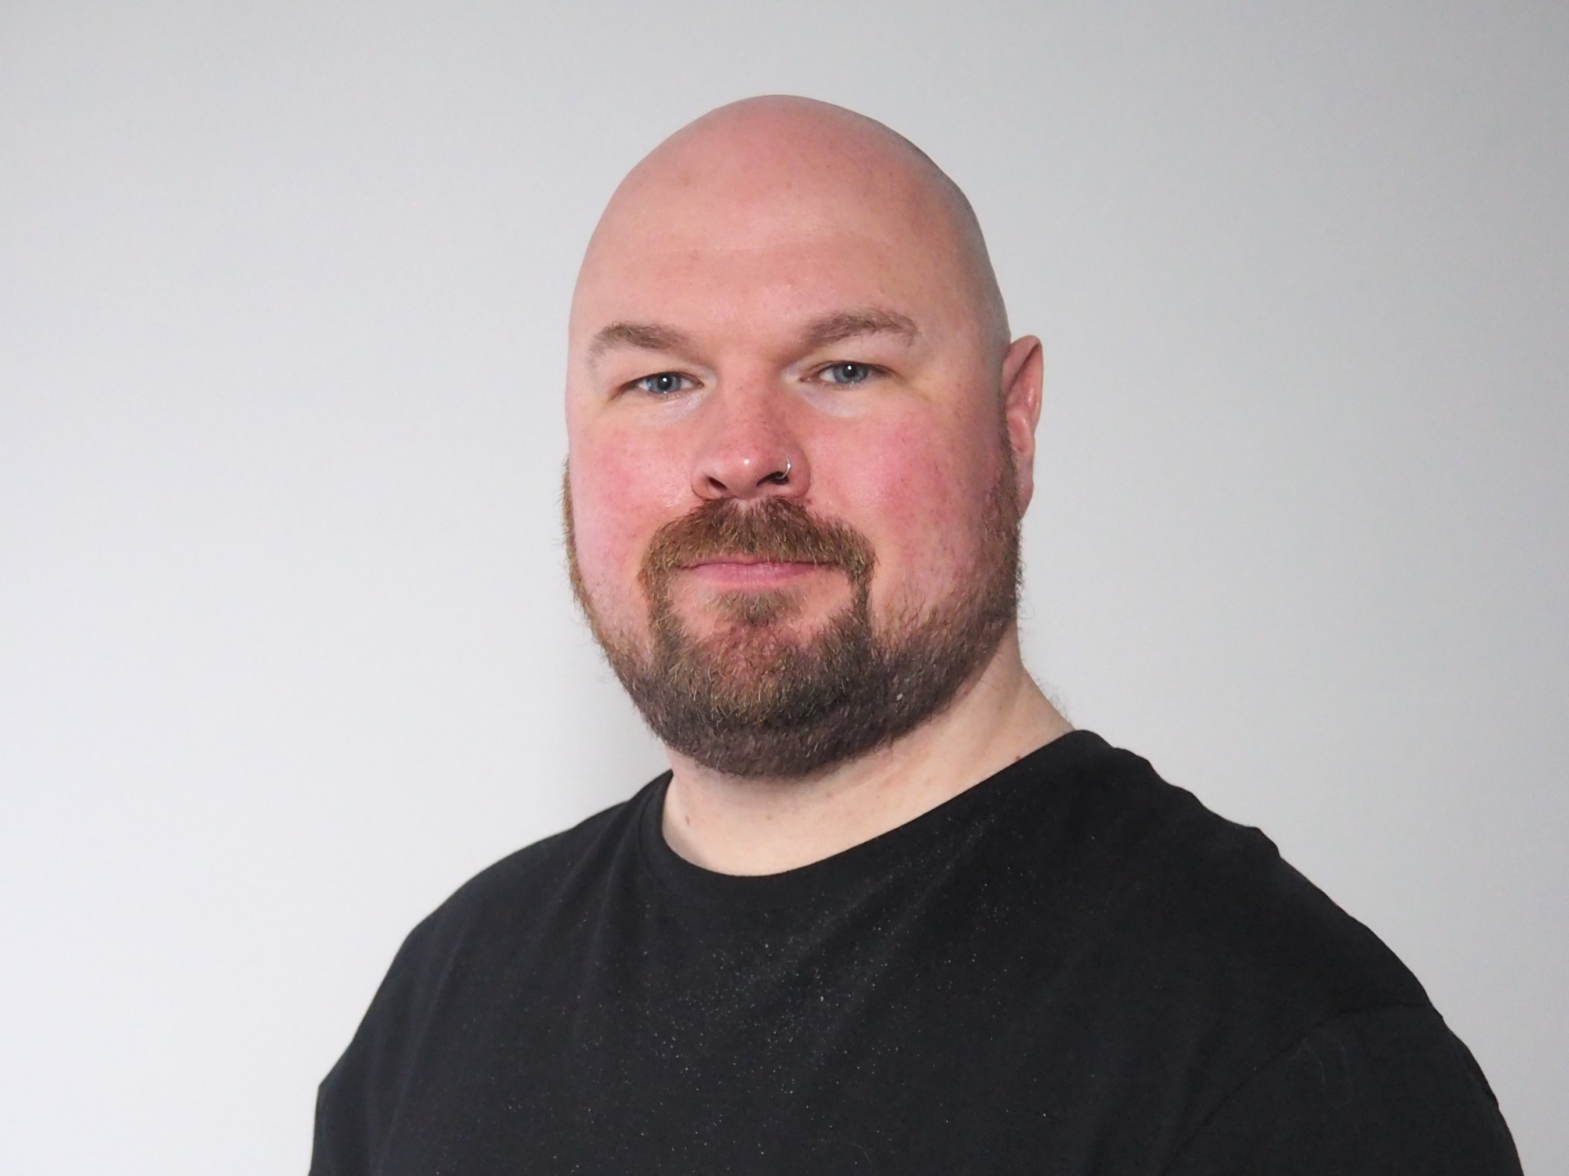
BY THE POWER OF ANALYTICS ENGINEERING!
ANALYTICS ENGINEERING
for MICROSOFT FABRIC
Johnny Winter

Slide 2
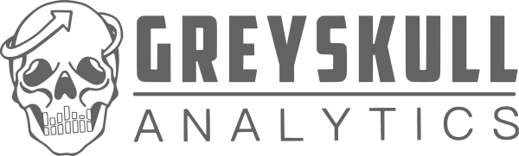
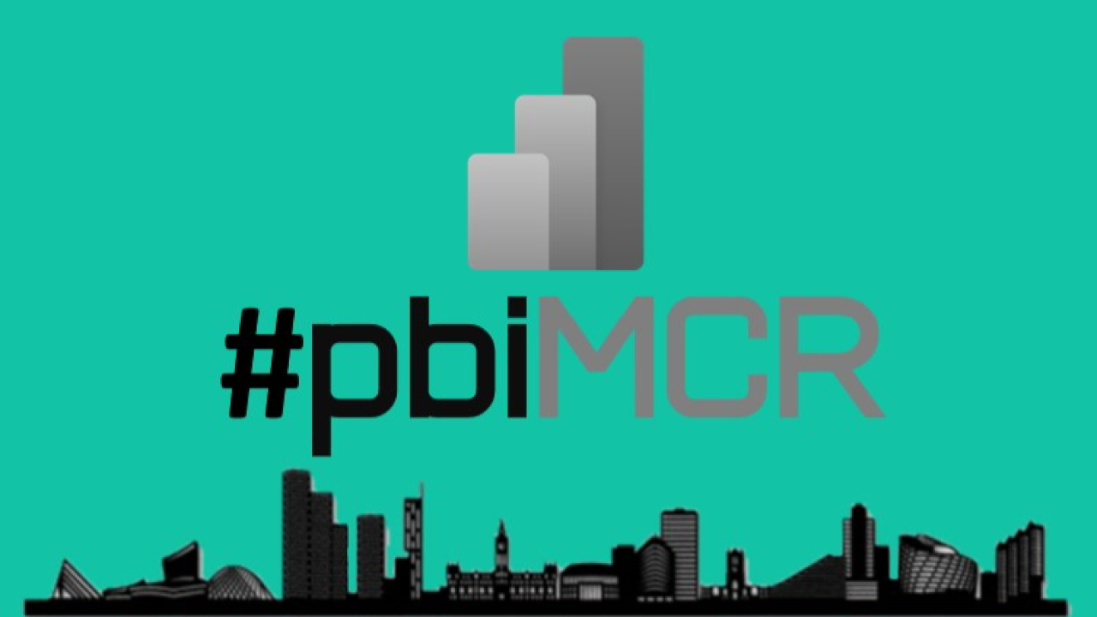
Johnny winter (HE/HIM)

Slide 3




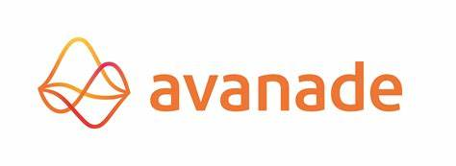


Slide 4
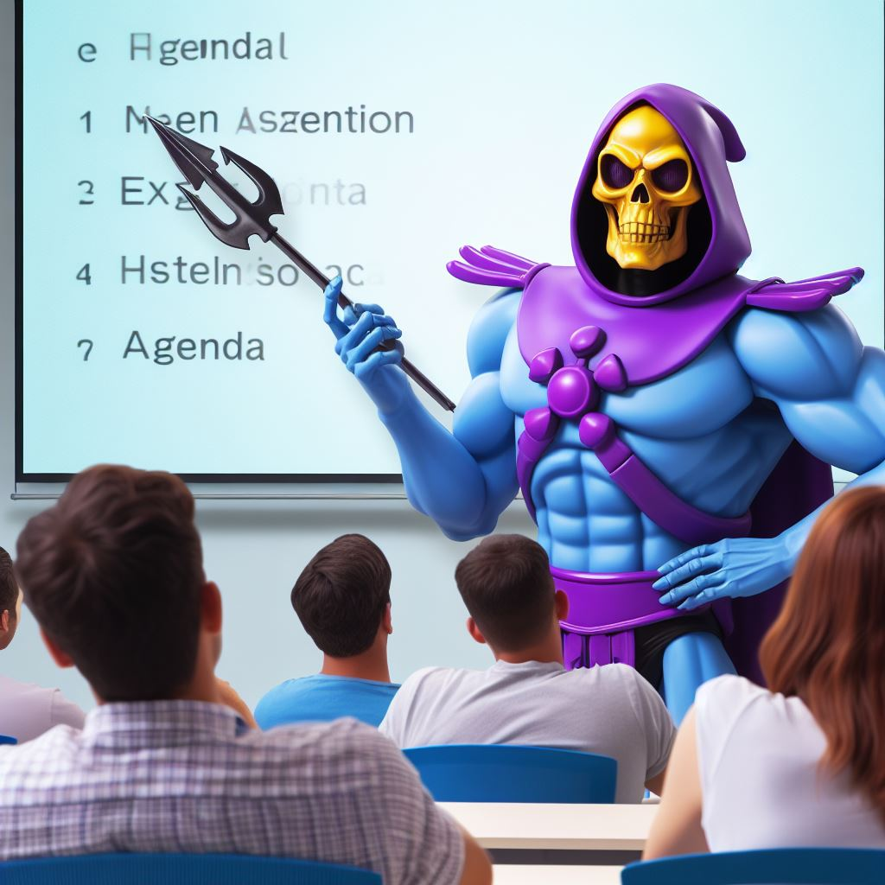
agenda
Why are we here?
What is Analytics Engineering?
How can I apply Analytics Engineering to Fabric and Power BI?

Slide 5
Why are we here?

Slide 6
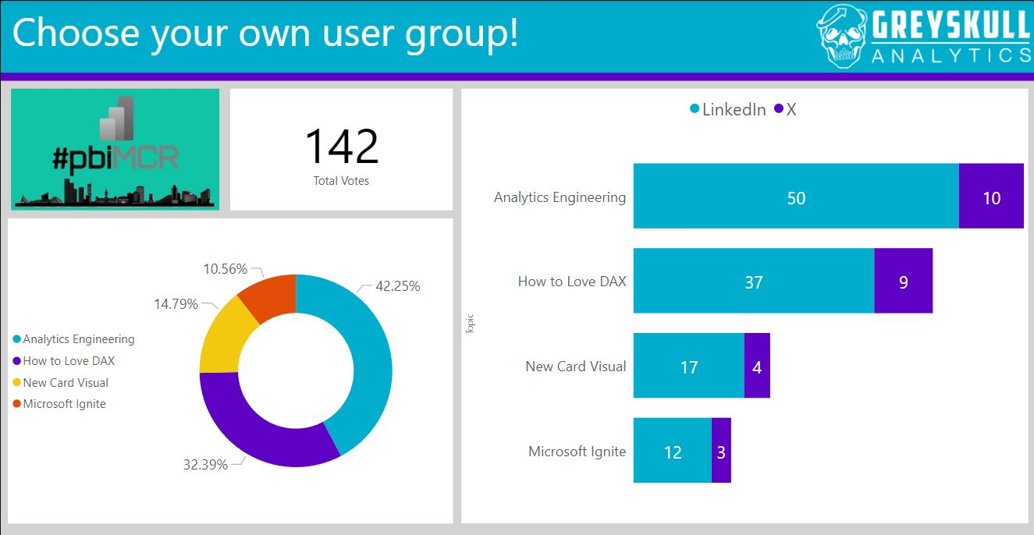
It’s your fault!!!

Slide 7
What is analytics engineering?

Slide 8
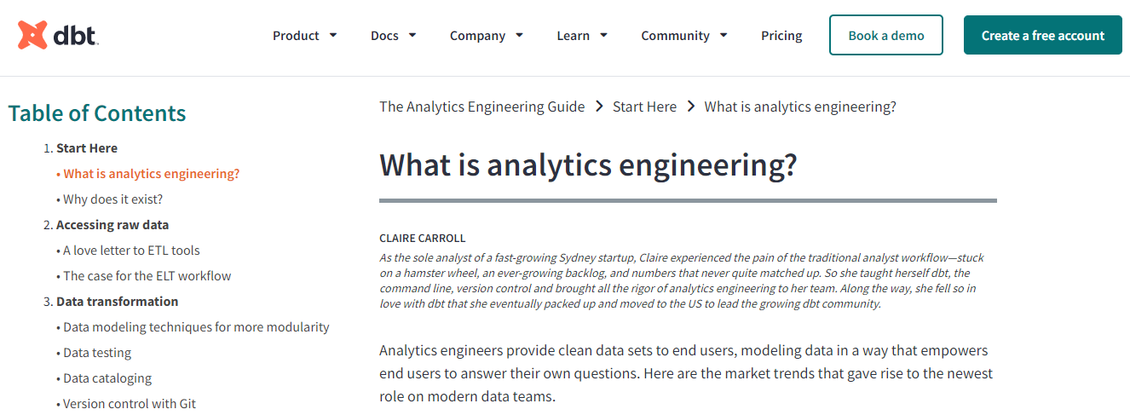
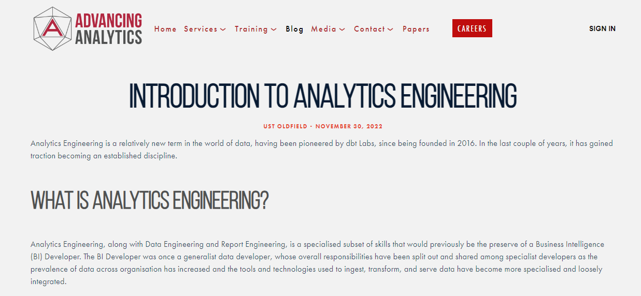
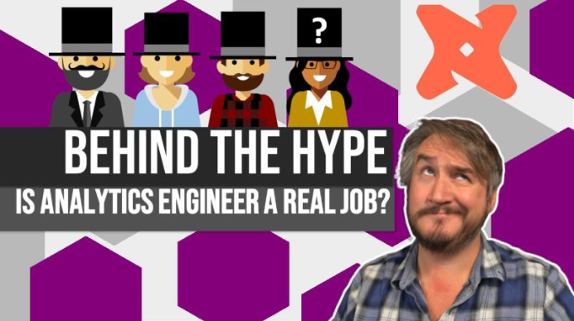

Slide 9



Business intelligence
SSIS
SSAS
SOURCES

Slide 10


Slide 11




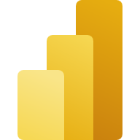





Technology changes
Data Factory
Pipelines
RAW
BASE
CURATED
Files
Tables
Tables
Tables
Data Factory
Copy
DELTA
DELTA
Direct Lake
DELTA
PowerBI
SOURCES

Slide 12
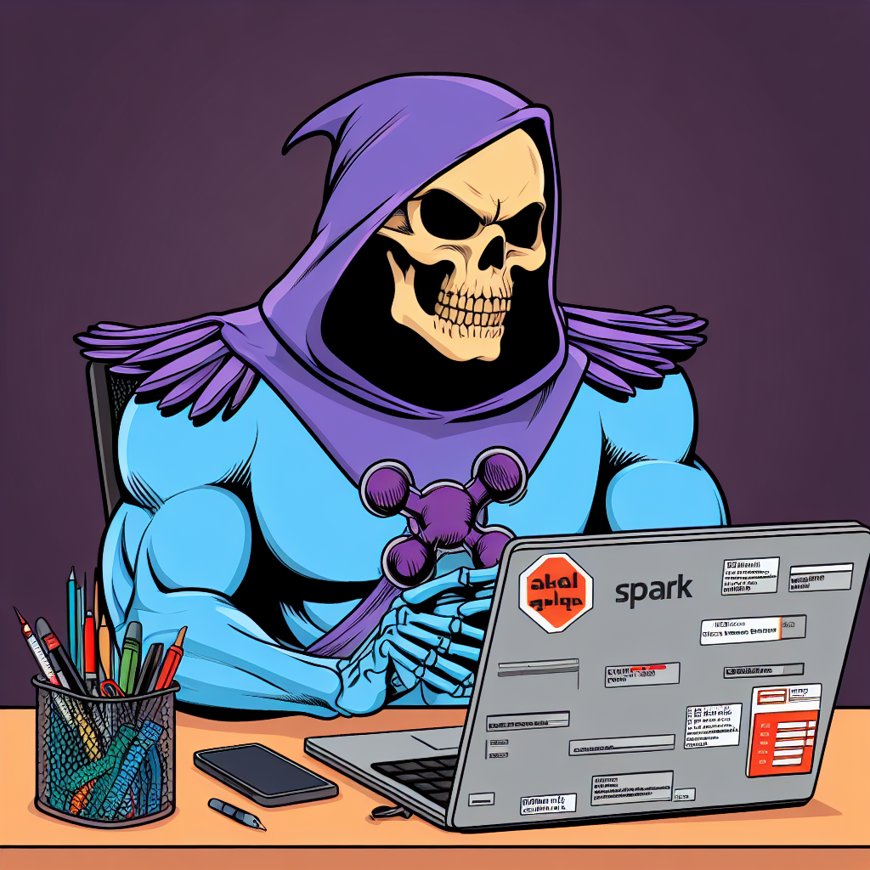
WORKING PRACTICE CHANGES
Code first based approaches (Spark, Scala, Python)
Infrastructure as Code (Terraform, Bicep)
Better source control practices
Continuous Integration / Continuous Deployment (CI/CD)
Testing
Automation

Slide 13
RISE OF THE DATA ENGINEER
DATA ENGINEERING
Data Factory
Pipelines
RAW
BASE
CURATED
Files
Tables
Tables
Tables
Data Factory
Copy
DELTA
DELTA
Direct Lake
DELTA
PowerBI
SOURCES

Slide 14
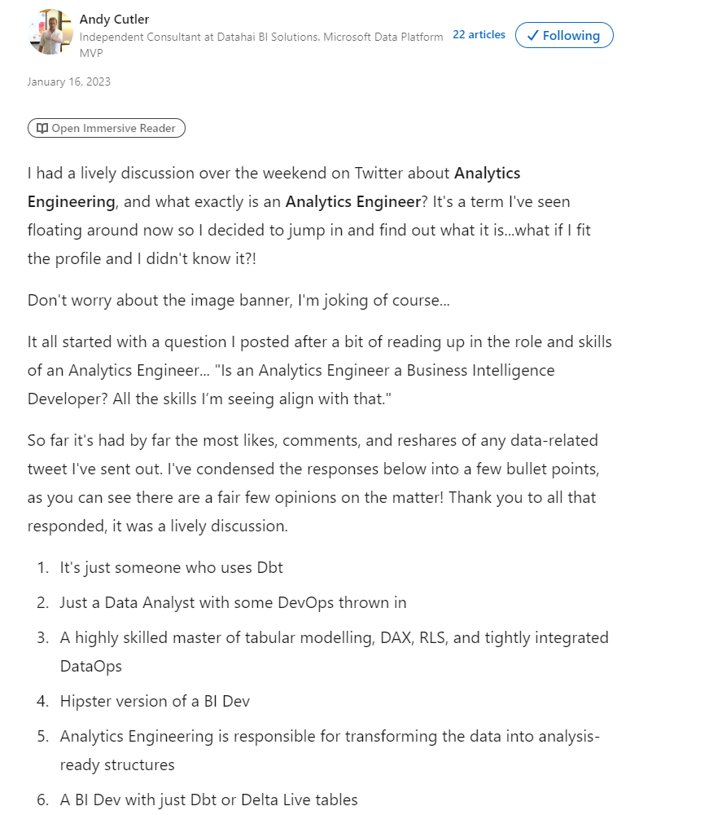
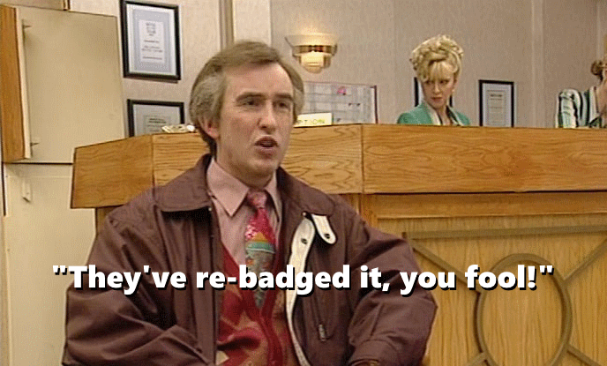
EMERGENCE OF ANALYTICS ENGINEERING

Slide 15
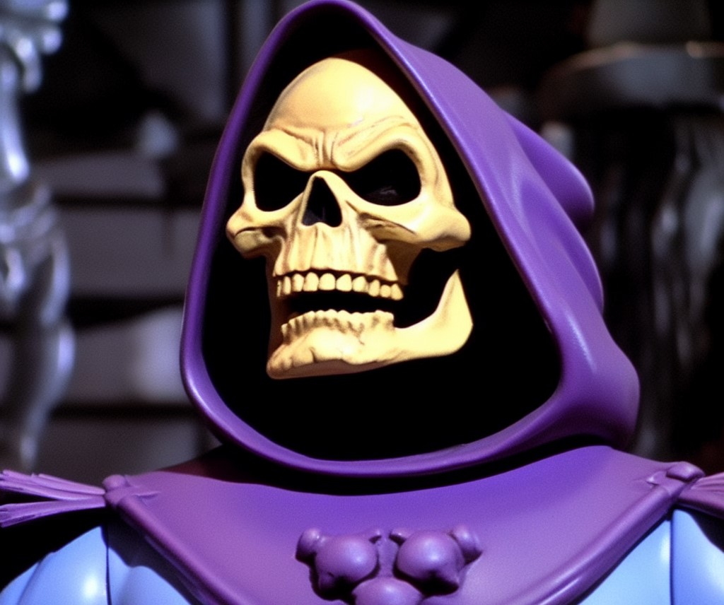
“They’ve re-badged it, you fool!”

Slide 16
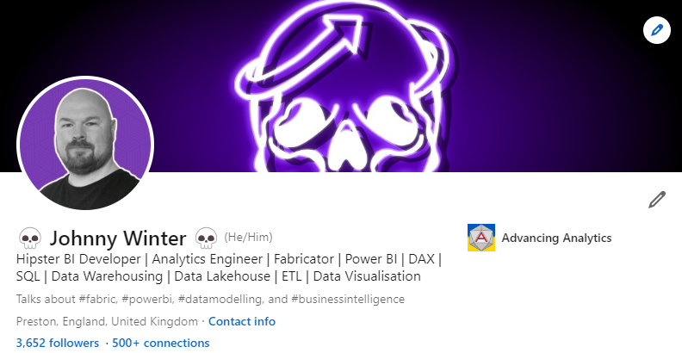

Slide 17
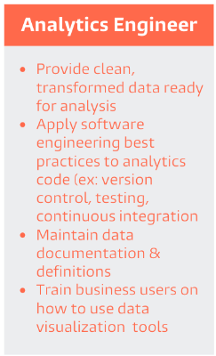

Slide 18
RISE OF THE ANALYTICS ENGINEER
ANALYTICS ENGINEERING
CURATED
Tables
DELTA
Direct Lake
PowerBI

Slide 19

BRIDGING THE GAP

Slide 20
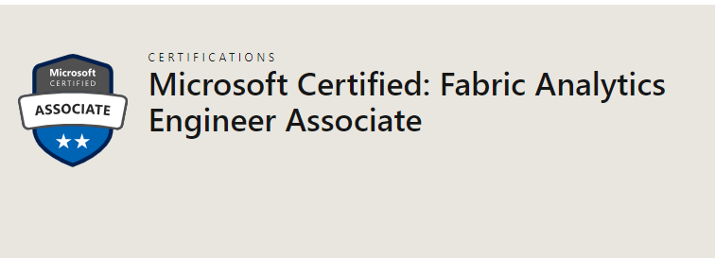
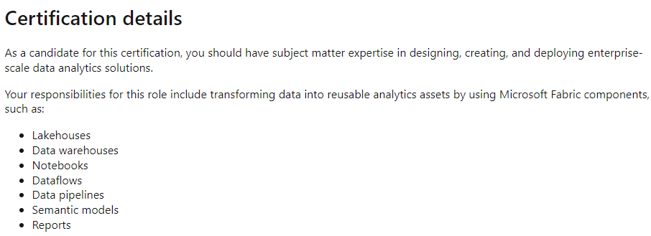
JUST TO CONFUSE YOU…

Slide 21
The Data OPS MANIFESTO
https://dataopsmanifesto.org/en/
9. Analytics is code:
Analytic teams use a variety of individual tools to access, integrate, model, and visualize data. Fundamentally, each of these tools generates code and configuration which describes the actions taken upon data to deliver insight.
11. Make it reproducible:
Reproducible results are required and therefore we version everything: data, low-level hardware and software configurations, and the code and configuration specific to each tool in the toolchain.
15. Quality is paramount:
Analytic pipelines should be built with a foundation capable of automated detection of abnormalities (jidoka) and security issues in code, configuration, and data, and should provide continuous feedback to operators for error avoidance (poka yoke).
17. Reuse:
We believe a foundational aspect of analytic insight manufacturing efficiency is to avoid the repetition of previous work by the individual or team.
18. Improve cycle times:
We should strive to minimize the time and effort to turn a customer need into an analytic idea, create it in development, release it as a repeatable production process, and finally refactor and reuse that product.

Slide 22
ANALYTICS ENGINEERING IN FABRIC

Slide 23


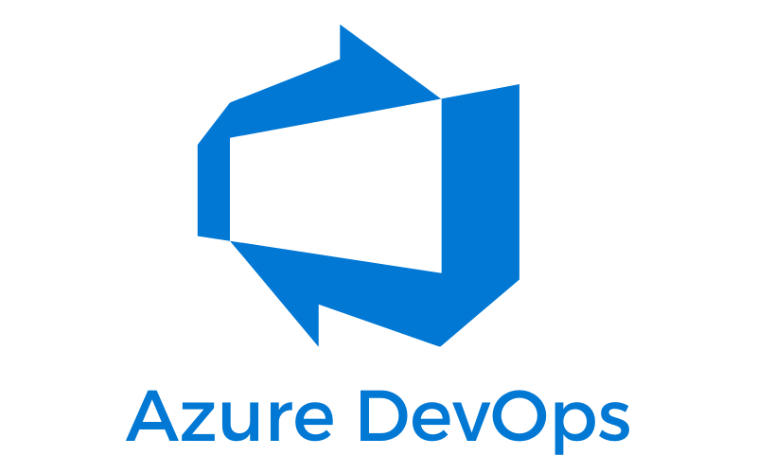
TOOLS FOR ANALYTICS ENGINEERS

Slide 24
dbt
data build tool
SQL-first transformation workflow – the “T” in ETL
Available as dbt-core or dbt-cloud
Fabric connectors announced for Data Warehouse

Slide 25
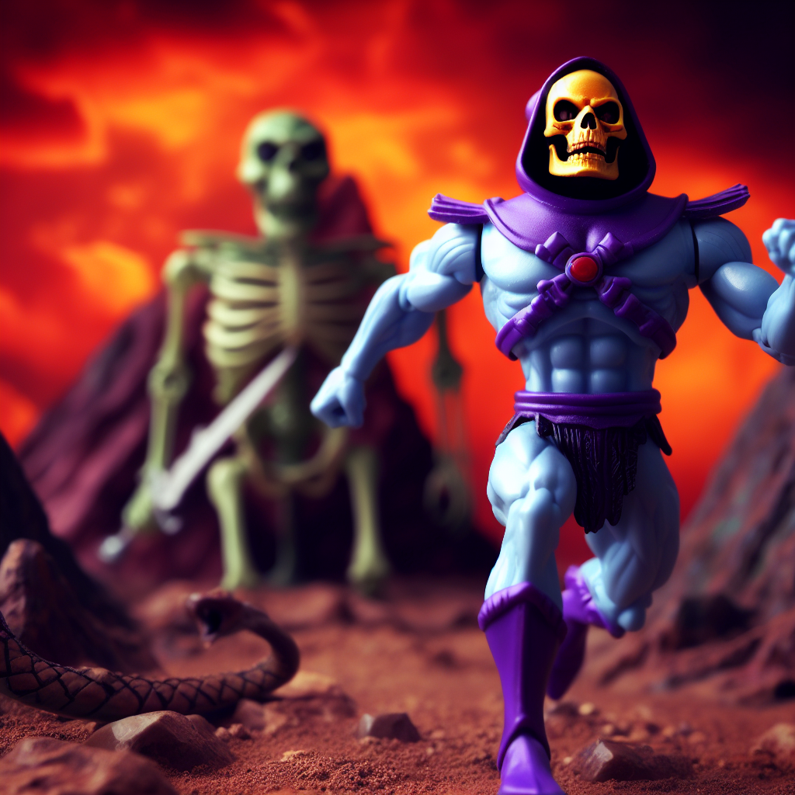
To the demo lair

Slide 26
TABULAR EDITOR
Used for building Semantic Models
Fabric and DirectLake compatible
Open source and licensed options available.

Slide 27

To the demo lair

Slide 28
AZURE DEV OPS
Can be used as a Git repository
Pipelines

Slide 29
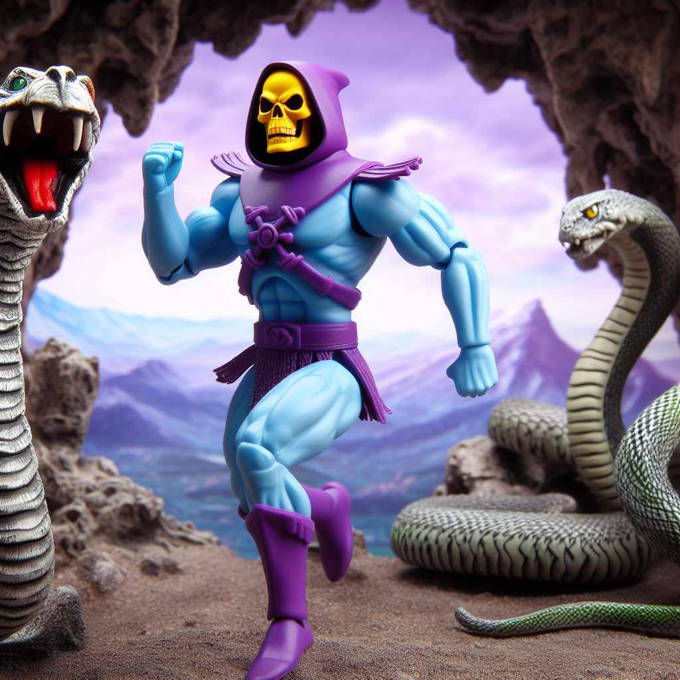
To the demo lair

Slide 30
 | Version Control | Testing | Continuous Integration | Documentation | Automation
dbt | Git repository | dbt Tests | Using Azure Dev Ops Pipelines | Generates own documentation | Macros
Tabular Editor | Git repository | Best Practice Analyzer | Using Azure Dev Ops Pipelines | Can use metadata to build documentation | C# Scripts

Slide 31
Questions?

Slide 32
THANK YOU!
Twitter:
@GreyskullPBI
LinkedIn: https://www.linkedin.com/in/j0hnnyw1nter/
Websites:
https://greyskullanalytics.com/
https://www.advancinganalytics.co.uk/

Slide 33
pbiMCR in 2024
Month | Venue | Speaker1 | Speaker2
Jan-24 |  | Ian Pike | Chris Webb
Feb-24 |  | Matt Lakin | Andy Cutler
Mar-24
Apr-24 |  | Laura Graham-Brown | Claire Edgson
May-24 | Eagle Labs | Brian Bønk | Damien Jones
Jun-24 |  | Tabular Editor Takeover | Tabular Editor Takeover
Jul-24 |  | Ben Howard | Antony Catella

Slide 34

45 minute sessions
or
Lightning Talk format? ⚡
or
Fresh Ideas? 💡
If interested contact Johnny:
johnny@greyskullanalytics.com

Slide 35
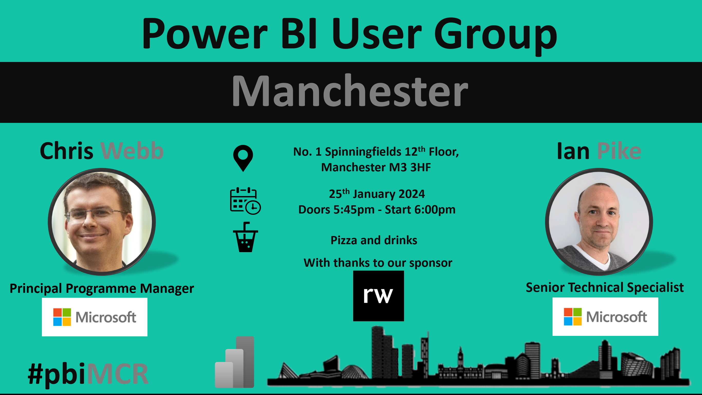

Slide 36

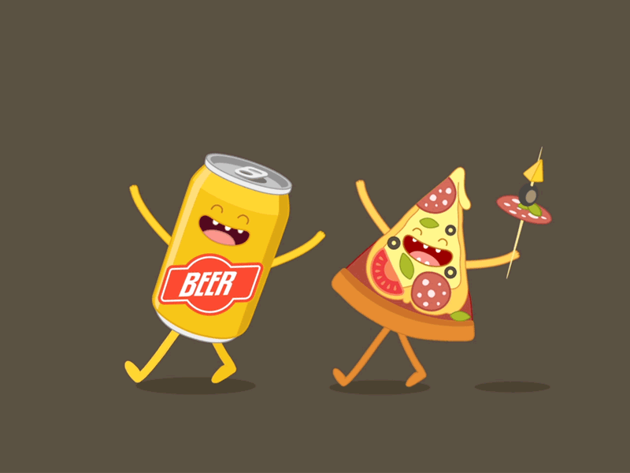
Pizza and beer time!

